Slide 1

Model Representation Cost Function

Slide 2
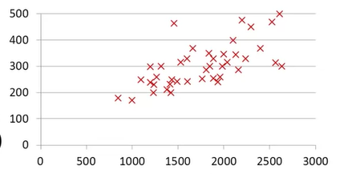
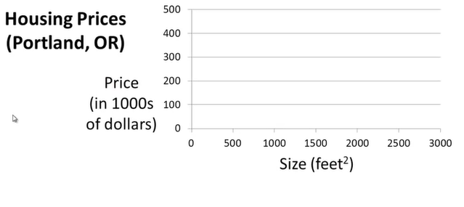

$$m^{2}$$
1250
Supervised .Learning .
Given the “right answer” for
each example in the data.
Regression .Problem .
Predict real-valued output .
Classification.
Desecrate valued output

Slide 3
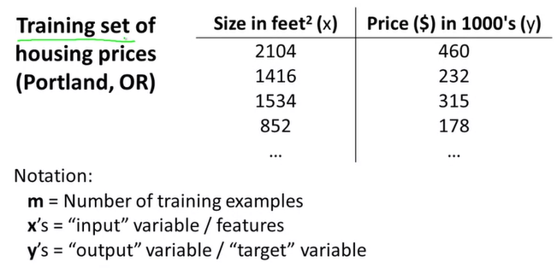

(x,y) – one training example
${(x}^{i},y^{i})$ – i-th training example

Slide 4
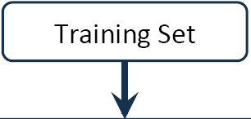
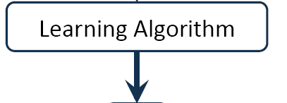
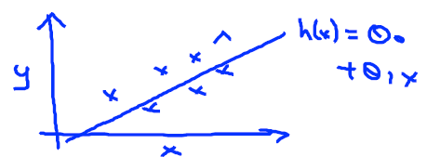


How do we represent h ?
$h_{θ}\left(x\right)=θ_{0}+θ_{1}x$
OR h(x)
X
hypothesis
Estimated
Value of Y
h maps from x’s and y’s
Linear regression with one variable.
Univariate linear regression.

Slide 5
Cost Function

Slide 6
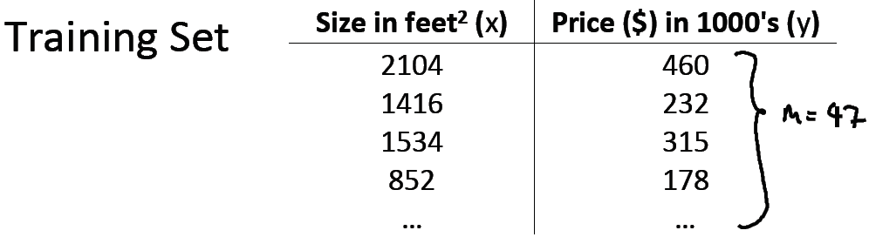
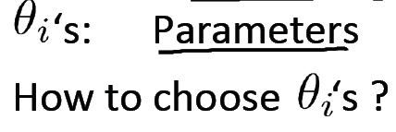

Hypothesis:
$h_{θ}\left(x\right)=θ_{0}+θ_{1}x$

Slide 7
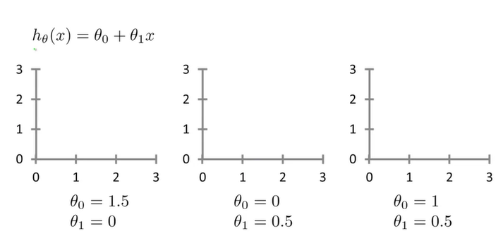
Different parameters

Slide 8
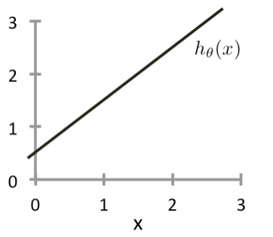
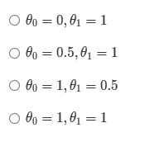
Example
Consider the plot below of hθ(x)=θ0+θ1x. What are θ0​ and θ1?

Slide 9
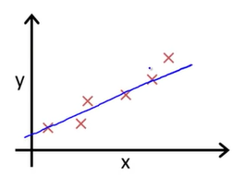
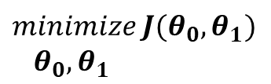
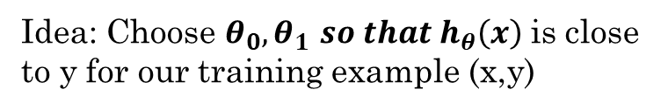
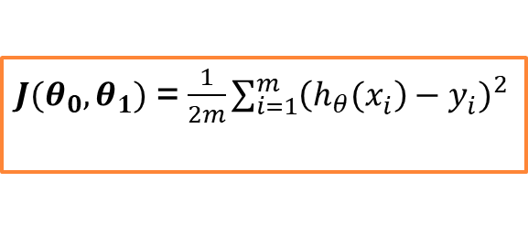

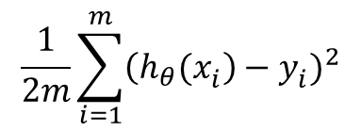
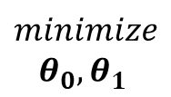
$$minimize$$
${ θ}_{0},θ_{1}$
$$\frac{1}{2m}\sum_{i=1}^{m}{{\left({h_{θ}(x}_{i}^{}\right)−y_{i}^{})}^{2}}$$
where $\left({h_{θ}(x}_{i}^{}\right))= θ_{0}+θ_{1}x_{i}$
${J(θ}_{0},θ_{1})$ = $\frac{1}{2m}\sum_{i=1}^{m}{{\left({h_{θ}(x}_{i}^{}\right)−y_{i}^{})}^{2}}$
Idea: Choose $θ_{0},θ_{1}$ ${so that h}_{θ}\left(x\right)$ is close to y for our training example (x,y)
$$minimize {J(θ}_{0},θ_{1})$$
${ θ}_{0},θ_{1}$
COST FUNCTION
OR
SQUARED ERROR COST FUNCTION

Slide 10
Linear regression with one variable
Cost function

Slide 11
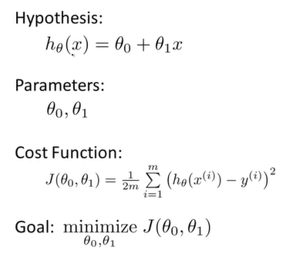




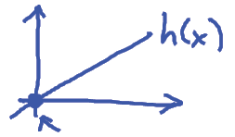
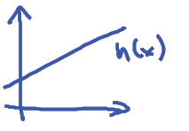

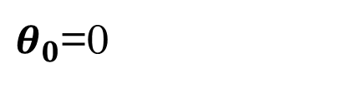
Simplified
$θ_{0}$=0
$$θ_{1}x_{i}$$

Slide 12
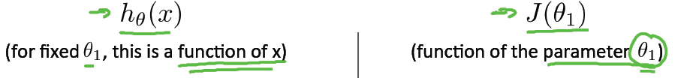
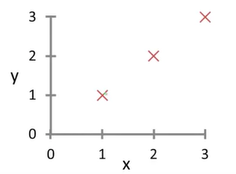
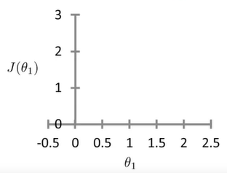
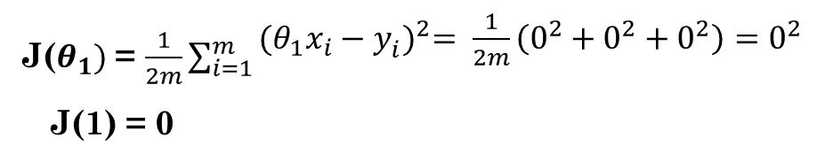
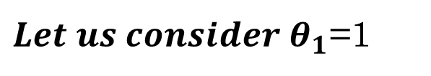



$$\left({h_{θ}(x}_{i}^{}\right))$$
x
x
x
x
x
${Let us consider θ}_{1}$=1
${Please consider θ}_{1}$=0.5; 0; …
$$minimize {J(θ}_{1})$$
J($θ_{1})$ = $\frac{1}{2m}\sum_{i=1}^{m}{\begin{aligned}{(θ_{1}x_{i}−y_{i}^{})}^{2}= \frac{1}{2m}\left(0^{2}+0^{2}+0^{2}\right)=0^{2} \\ \end{aligned}}$
J(1) = 0

Slide 13
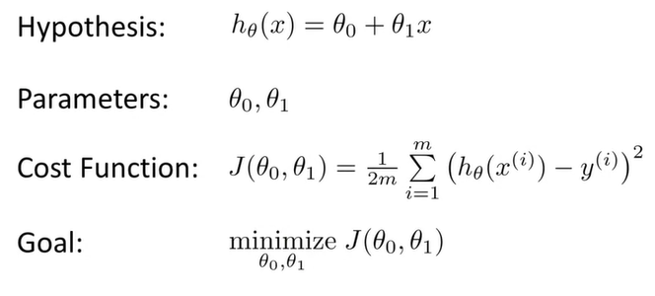
Not simplified version

Slide 14
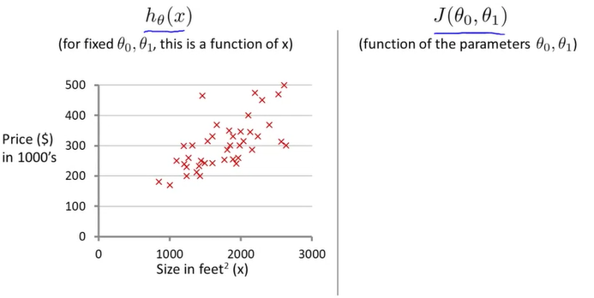
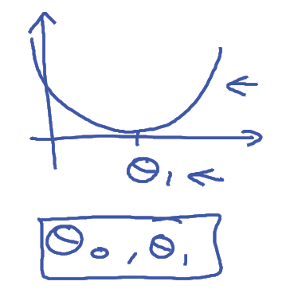


$$m^{2}$$
$$h_{θ}\left(x\right)=50+0.06x$$

Slide 15
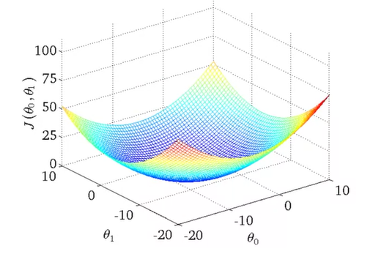
3D plot

Slide 16
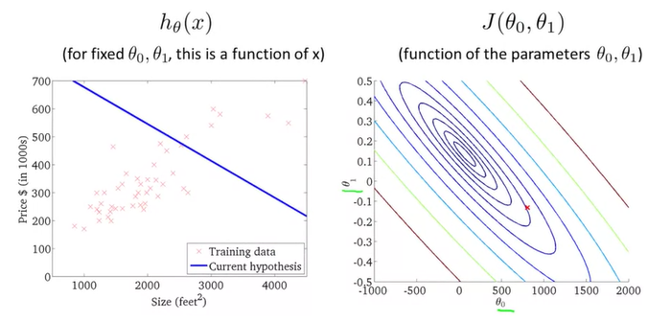
Contour figures

Slide 17
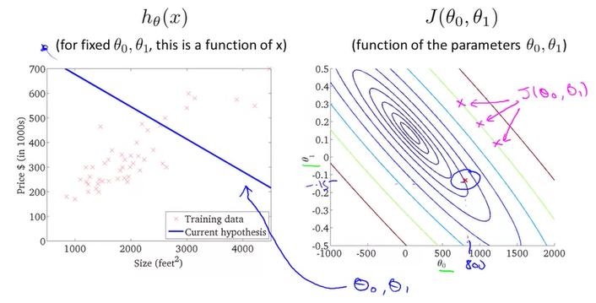
Contour figures

Slide 18
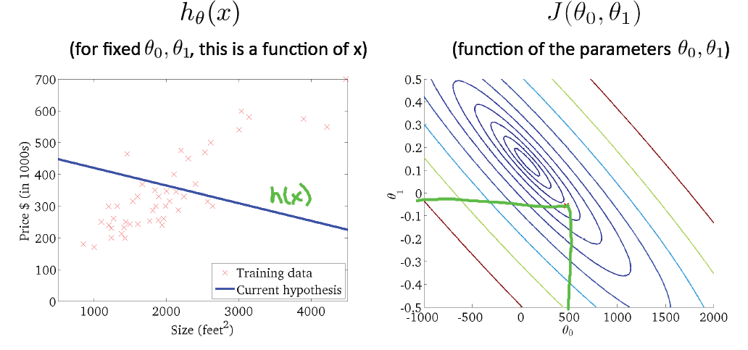
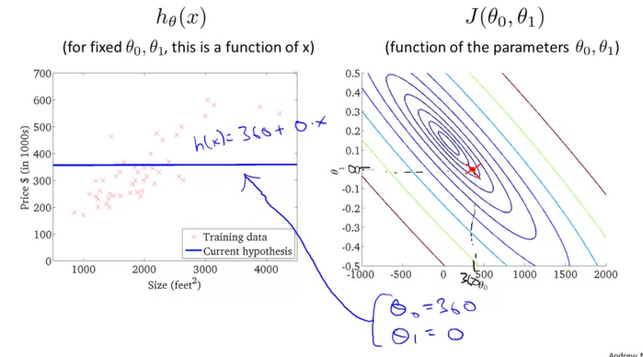
Contour figures

Slide 19
Contour figures

Slide 20
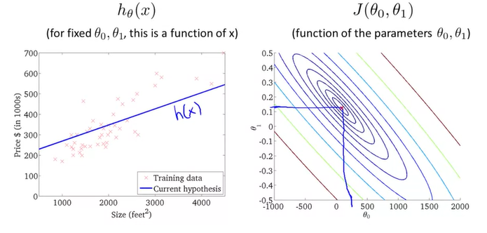
Contour figures

